Slide 1
Welcome to the 2021-2022 Title I Annual Parent Meeting
Mater Lakes Academy Middle
September 23rd 2021
6:00 PM
Zoom ID: 601 215 4179
Principal- Rene Rovirosa
Notes:
Note: This presentation may be utilized for virtual and in person meetings. All schools are required to update the presentation with the school’s information (see highlighted sections on each slide).
Schools are encouraged to insert pictures/graphics/videos into their presentation. Families should be encouraged to provide input and feedback. The purpose of this presentation is to provide Title I required information with parents and families as well as fully engage them with the presentation.
To engage the audience, the presenter may provide opportunities for participants to answer slide title questions, read slide information, ask questions, respond to questions, and read aloud some of the responses provided.
Other ideas to engage the audience, have students assist with the presentation, have a post-it note board for questions, have audience use technology (Phones, laptops, computer lab setting, iPad etc.)to follow along and use live links included in the presentation, take photos during the presentation and post, use links as virtual field trips and scavenger hunts to find information, use technology for participant surveys during the presentation (examples: Mentimeter, Quizlet)
Please designate someone to take meeting minutes that can later be made available to parents/families on school website and is kept in the Title I Compliance filing system.

Slide 2
What topics will you learn about today?
AGENDA
All About Title I
Title I Schoolwide Funds
Title I District-level Parent and Family Engagement Plan (PFEP)
Title I School-level PFEP
School Improvement Process (SIP)
School Achievement and Performance Data
Curriculum, Instruction & Assessment
Title I School-Parent Compact
2
Notes:
Note: Slide #1, #2 , and #3 (2 slides per page) should be printed and placed in folder VI.3 and VI.6 (in corresponding month) of the Title I School-level Compliance Filing system.
To engage participants - ask the title question and have participants read bullets.

Slide 3
What topics will you learn about today?
AGENDA
SIP and School-Parent Compact
Parents, Families, and Schools Working Together
Parent’s Right-to-Know
Coordination with Other Federal Programs
School-level Parent and Family Engagement Survey
Consultation and Complaint Procedures
Project UP-START
School Contact Information
3
Notes:
Note: Slide #3 is a continuation of slide #2
Slide #1, #2, and #3 (2 slides per page) should be printed and placed in folder VI.3 and VI.6 (in corresponding month) of the Title I School-level Compliance Filing system.
To engage participants - ask the title question and have participants read bullets.

Slide 4
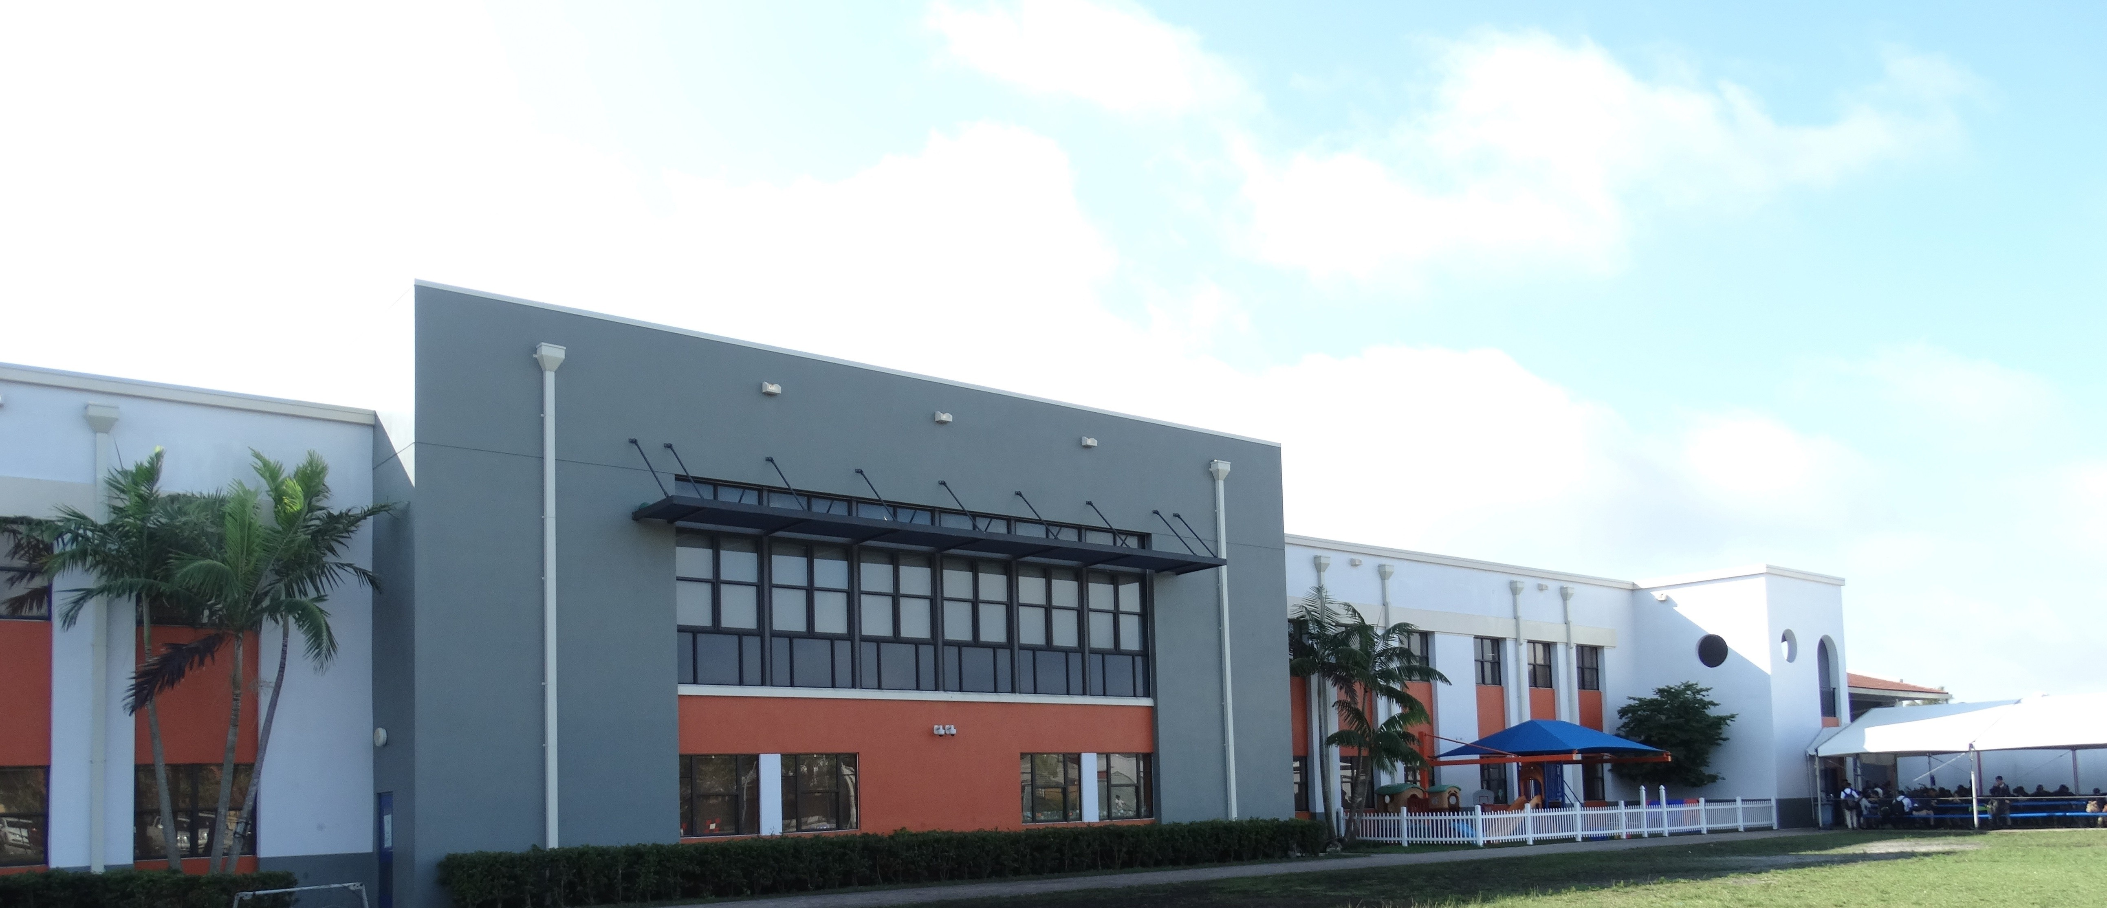
What is the Purpose of this Meeting?
Federal guidelines require Title I schools to hold an Annual Parent Meeting to explain and discuss the Title I Schoolwide Program requirements.
Mater Lakes Academy is a Title I School
4
Notes:
If possible, include a welcome message on your marquee for students, parents & families. You may also include a slide showing the school marque message.

Slide 5
Title I is the largest federally funded education program under the
Every Student Succeeds Act (ESSA)
It is designed to provide students with additional help in Reading, Language Arts, Mathematics, Science and Social Studies.
Its main objective is to support schools and districts in order to ensure that highly quality education is equitable for all students.
The Title I Schoolwide Program is committed to helping schools close the achievement gap between disadvantaged and minority students and their peers.
To learn more, please visit http://title1.dadeschools.net. This site is designed to supply users with information relevant to Title I, to provide a clear understanding of the overall program.
5
Notes:
To engage participants – allow participants to provide input/enter comments/questions. Use this opportunity to ask questions (example, How many of you have heard of the Every Student Succeeds Act EESA? Yes/No, Does anyone know when it was signed into law? 2010).
To engage participants- have participants use link to visit the Title I web site.

Slide 6
How do The Every Student Succeeds Act (ESSA) and the Title I Parent and Family Engagement Requirements help parents and families?
The school district and all Title I schools must allocate a portion of their Title I budget towards programs, activities, and procedures for parent and family engagement.
The school district and all Title I schools must develop with, and distribute to parents and family members a written Title I Parent and Family Engagement Plan (PFEP).
All Title I schools are required to collaborate with parents and families in the development of the School Improvement Process (SIP) and School-Parent Compact.
https://tinyurl.com/bddcrpe7 ( Link to documents on school website)
6
Notes:
Inform meeting participants that the 2020-2021 Title I School-level PFEP, District-level PFEP, SIP, and School Parent Compact are located on our school’s website.
To engage participants – use link to navigate school web site and view documents.
To engage participants - allow the opportunity for parents/families to enter their comments. Read aloud some of the responses.

Slide 7
Where can you access title I Compliance Documents?
7
Notes:
Inform meeting participants of the availability of the Title I Notification Flyer posted on the school’s website and at title1.dadeschools.net. Provide directions for accessing the flyer.

Slide 8
How is title I funding provided for your child’s school?
A portion of the Title I Schoolwide Funds are used to fulfill the parent and family engagement requirements in the ESSA law and provide supplemental materials and resources. The Educational Excellence School Advisory Council (EESAC) is the official forum to discuss the details of Title I funding.
Schoolwide Funds for Middle ( 6033)
Amount of funds available for this school year
$__ 294,244.00 _________
Title I Parent and Family Engagement Funds
Amount of funds available for this school year: $___5,669.00__________
8
Notes:
Inform meeting participants that they may view additional information on how Title I funds are utilized in the Title I Handbook located on the Title I website under Compliance. Provide calendar/schedule of EESAC meetings to meeting participants and invite them to attend.
To engage participants – ask for input regarding how to best allocate the school’s available Title I funds (share how the funds were used the previous year) allow participants an opportunity to respond. Read aloud some of the responses.

Slide 9
What is the Title I District-level PFEP?
The Title I District-level PFEP is a blueprint of how the District Local Educational Agency (LEA) and Title I schools will work together with parents and family members to establish expectations for family engagement and strengthen student academic achievement.
The Title I District-level PFEP describes how the District will:
provide the coordination, technical assistance, and other support actions to assist schools in planning and implementing effective parent and family engagement activities, and
conduct, with meaningful involvement of parents and family members, an annual evaluation of the content and effectiveness of the parent and family engagement plan towards improving the academic quality of all schools served under Title I, Part A.
9
Notes:
Schools may include a link to the Title I District-level PFEP on this slide and provide directions for accessing it on the school’s website.
To engage participants – ask where can the District-level PFEP be located? (Title I web site/School web site)

Slide 10
What is Our Title I School-level PFEP?
The School-level PFEP is a blueprint of how Mater Lakes Academy will work together with parents, family members, and the community to establish expectations for family engagement and strengthen student academic achievement.
10
Notes:
Note: slides #9, #10, #11, #12 go together
To engage participants - allow meeting participants to provide feedback on the information presented. Ask if there are any questions/feedback.
To engage participants - provide an opportunity for meeting participants to share how they prefer to receive information from the school.

Slide 11
What is Our Title I School-level PFEP?
Describes how the school will:
Convene an annual meeting to inform parents and family members of their rights to be involved in the Title I program;
EESAC meetings are conducted every quarter, on the second Thursday of every month allowing for flexible scheduling. The presentation slides for each meeting are available by request.
Offer meetings at flexible times to maximize participation;
Provide parents and family members with timely information about Title I programs. These will be communicated through:
school messenger ( phone and email), flyers sent home in backpacks, school website ( www.materlakes.org, school social media ( Facebook, Instagram, Twitter)
11
Notes:
Note: slides #9, #10, #11, #12 go together
At this time you may provide the opportunity for the ESSAC Chairperson to greet meeting participants and invite them to the next ESSAC Meeting. EESAC representative should inform meeting participants how they may access the EESAC calendar for upcoming meetings and provide information/directions for virtual meetings, as applicable.

Slide 12
What is Our Title I School-level PFEP?
Describes how the school will:
Involve parents, in an organized, ongoing, and timely manner, in the planning, reviewing, and improvement of schoolwide activities and involve parents and families in the planning, reviewing, and improvement of documents required by the Title I Program such as: the Title I School-level PFEP, the School-Parent Compact, and the joint development of the Title I schoolwide program plan (School Improvement Process [SIP]); Participate in school functions, serving as volunteers, assist in teacher appreciation week, family and fun functions (events), FAFSA trainings, University presentations. Senior and Junior parent night
12
Notes:
Note: slides #9, #10, #11, #12 go together
You may ask for the ESSAC Chairperson to greet meeting participants and invite them to the next ESSAC Meeting. EESAC representative should inform meeting participants how they may access the EESAC calendar for upcoming meetings and provide information/directions for virtual meetings, as applicable.

Slide 13
What is Our Title I School-level PFEP?
Describes how the school will:
Assist parents and families in understanding academic content standards, assessments, and how to monitor and improve the academic achievement of their children; and
Through parent teacher conferences held quarterly and as needed, EESAC meetings, Gradebook/portal, our new platform Colegia
Provide training to assist parents and families of students enrolled in schools implementing the Title I Schoolwide Program to improve their child’s academic achievement.
Tutoring Programs, Parent Academy, CAP (College Advisory Program)
13
Notes:
Note: slides #9, #10, #11, #12 go together
To engage participants - Schools may share the new platform My School Online (MSO) with meeting participants . You may take this opportunity to survey meeting participants to inquire if they have assisted their children with utilizing MSO.

Slide 14
What is Our School Improvement Process (SIP)?
Our School’s Mission Statement
The Vision of Mater Lakes Academy, Inc. is to provide students a viable educational choice that offers an innovative, rigorous, and seamless college preparatory curriculum, providing Mater students, at every level from PK-12th grade, with a competitive advantage against their contemporaries. To that end, Mater Schools strive to:
create a thirst for knowledge in all disciplines;
kindle the art of thinking and serve as a springboard for lifelong learning; and
deliver and enrich every student with a sense of purpose, a belief in their own efficacy, and a commitment to the common good
14
Notes:
Note: Slides #13 and #14 go together
Remind meeting participants where they can view the SIP.

Slide 15
What is Our School Improvement Process (SIP)?
Our School’s Goal for 2021-2022 (Middle 6033)
ELA: From _73____ to ___78__
Math: From __79____ to __84___
EOCs: From __81____ to ___86_
Science: From __58____ to __70___
15
Notes:
Note: Slides #13 and #14 go together

Slide 16
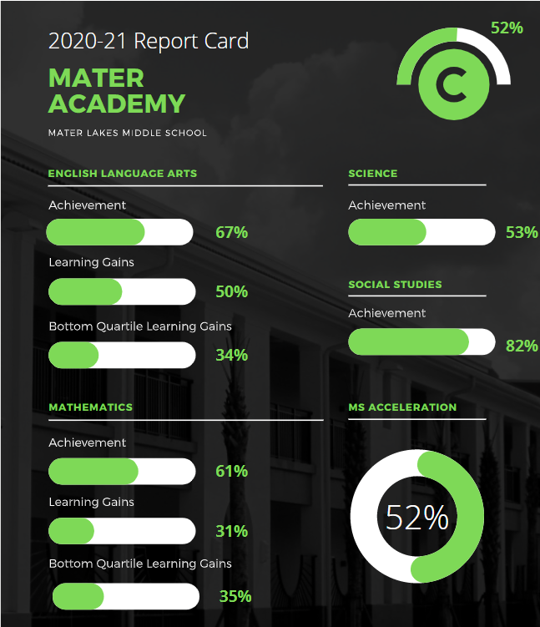
How Do we use Our School Achievement Data?
The data from the previous school year’s test results was used to create learning goals on the Schoolwide Improvement Plan
16
Notes:
Note: Slide #15 and #16 go together.
To engage participants - allow the opportunity for meeting participants to provide input/feedback. You may ask questions based on the information discussed.

Slide 17
How Do we use Our School Achievement Data?
Our school uses data to align the curriculum to State and District academic standards.
Our instructional practices are adjusted based on the findings of the assessment data.
For further details about our school achievement data, we invite you to attend the EESAC meetings throughout the school year.
17
Notes:
Note: Slide #15 and #16 go together.
To engage participants - allow the opportunity for meeting participants to provide input/feedback. You may ask questions based on the information discussed.

Slide 18
What is the School-Parent Compact?
Each Title I school must have a School-Parent Compact that is developed jointly by parents and school personnel.
The compact sets out the responsibilities of the students, parents, and school staff in striving to raise student academic achievement.
At the elementary grades (K- 5 only), the compact will be discussed and amended during parent-teacher conferences and documented in a teacher communication log.
https://tinyurl.com/2p84rvy6 ( Link on school website to Parent Compact)
18
Notes:
To engage participants – access the School-Parent Compact using the link and review/discuss the School-Parent Compact with participants and allow time for feedback/comments.

Slide 19
What does School and Parent Collaboration look like?
Our school offers workshops, trainings, and parent/teacher conferences at flexible meeting times including our Open House, scheduled for September 15, 2021 and a Parent Resource Center/Area which is available between the hours of 8:30 am-3 pm and a virtual resource center which is accessible 24 hours/7 days a week;
School and parent partnerships are built within advisory councils such as the Educational Excellence School Advisory Council (EESAC), the Title I District Advisory Council (DAC), and the North Region Parent Advisory Council (PAC);
Title I DAC and Region PAC members are representatives of parents who consult with the District Title I DAC on the planning and implementation of the Title I Schoolwide Program.
19
Notes:
Note: Slides #18 and #19 go together.
To engage participants – survey parents regarding their input on how to best collaborate with the school.
Inform meeting participants of the method the school will utilize to inform parents/families of upcoming meetings, etc. Describe how meeting notices/invites (including virtual meetings) will be sent/made available to parents/families. Describe how the school will keep all parents informed, specifically parents who may be unable to attend virtual/in person meetings (ex. archived virtual meetings).

Slide 20
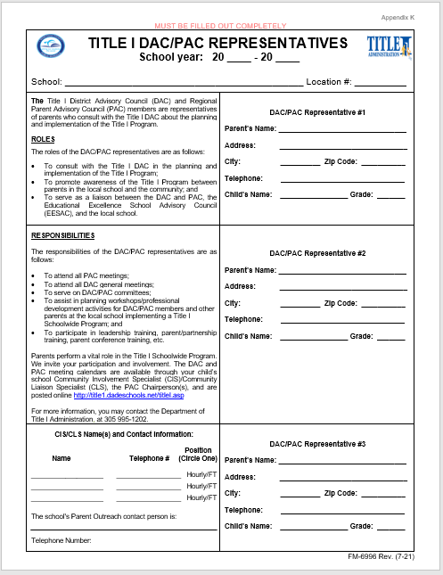
What does School and Parent Collaboration look like?
The school conducts elections for Title I DAC/PAC Representatives.
Conduct elections
20
Notes:
Note: Slides #18 and #19 go together.
To engage participants – open the floor for nominations to service as DAC/PAC Representatives for your school.
Inform meeting participants that the Title I District Advisory Council and Parent Advisory Council Meetings will be conducted virtually. Additional information regarding the Title I DAC and PAC meetings will be forthcoming. Encourage meeting participants to visit the Title I Website for additional information regarding the Title I DAC and PAC.

Slide 21
What is the Parent’s Right-to-Know?
Parents have the right to request and receive timely information regarding the professional qualifications of their child’s teachers and paraprofessionals.
Parents must be notified if their child is assigned to, or taught, by a teacher who does not meet state certification requirements for the grade level or subject area for four (4) or more consecutive weeks.
Parents should be provided information regarding the level of academic achievement of their child on State required academic assessments.
To the extent that it is feasible, information must be in a language that parents can understand.
21
Notes:
Inform meeting participants how each Parents Right-to-Know communication will be provided by the school.

Slide 22
What other Federal Programs are offered at our school?
Project UP-START
22
Notes:
Note: schools should only include the federal programs available at their school. Describe how the school will coordinate and integrate parent and family engagement programs and activities with each Federal Program, as applicable.

Slide 23
How can parents and families provide input?
Parent and Family Engagement Survey
Please complete the 2021-2022 Title I School-level Parent and Family Engagement Survey located at https://forms.gle/UShfWp1VnFdLXBA77 (English) and https://forms.gle/pKGPxwf7zDjXFdbt8 (Spanish) in order to assist with the implementation of a Title I Schoolwide Program that meets the needs of your family.
The results of this survey will be utilized to help in the development of the Title I School-level Parent and Family Engagement Plan (PFEP), and to plan future parent and family engagement activities, events, and workshops at Mater Lakes Academy
23
Notes:
Encourage meeting participants to complete and submit the 2021-2022 Title I School-level Parent and Family Engagement Survey. Inform parents/families how they may gain access to the survey in multiple languages and the method for the submission of the survey. Share link to survey on the school’s website. Have paper surveys available for participants to complete.
Note: The CIS/CLS (or School-level Compliance Facilitator in the absence of a CIS/CLS) will complete Compilation of Survey Results using template from Title I Collaboration Site – Folder VI.4.

Slide 24
What are the
Consultation and Complaint Procedures?
See page 14-16 of the 2021-2022 Title I Handbook.
https://api.dadeschools.net/
24
Notes:
An administrator will include an overview of the Consultation and Complaint Procedures at the school as stipulated in the Title I Consultation and Complaint Procedures (See page 14-16 of the 2021-2022 Title I Handbook).

Slide 25
Project UP-START seeks to ensure a successful educational experience for children and youth living with unstable housing in Miami-Dade County.
What is PROJECT UP-START?
25
Notes:
Note: Slides #24, #25, #26, #27 go together.
To engage participants – have participants read slides.

Slide 26
Every Student Succeeds Act (ESSA) McKinney-Vento Act
What is PROJECT UP-START?
Provides additional support services to any student who is currently experiencing unstable housing.
Identification
Enrollment
Attendance
Academic support
26
Notes:
Note: Slides #24, #25, #26, #27 go together.
To engage participants – have participants read slides.

Slide 27
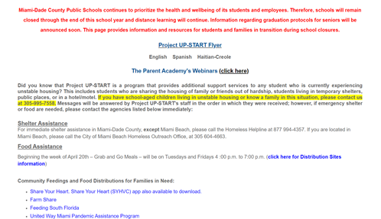
What Resources are available via PROJECT UP-START?
Website
@projectupstart
@projectupstart
@projectupstart
27
Notes:
Note: Slides #24, #25, #26, #27 go together.
To engage participants – have participants read slides.

Slide 28
How to contact PROJECT UP-START?
Project UP-START
305 995-7318
305 995-7558 305 995-7583
Fax: 305 579-0370
Projectupstart@dadeschools.net
Monday-Friday: 8:00 am - 4:30 pm
Follow us @projectupstart
http://projectupstart.dadeschools.net
28
Notes:
Note: Slides #24, #25, #26, #27 go together.
To engage participants – have participants read slides.
Let participants know to call the Project UP-START office before visiting to schedule an appointment.

Slide 29
How to contact School personnel?
Rene Rovirosa
Principal
Marjorie Enriquez
Vice Principal
Alice Martinez
Assistant Principal
Jennifer Paez
Title 1 Facilitator
29
Notes:
Allow school staff to greet parents/families. Encourage school staff to insert pictures so parents and families may be able to view this presentation later if archived, and for easier identification of relevant staff.

Slide 30
What Questions do you have?
Thank You for Your Participation!
30
Notes:
Address question and concerns from participants. Inform how the school will respond to all questions/concerns posed/posted on the post-it note question board during the meeting if time does not permit.

Slide 31
Comments/Feedback
31
Notes:
Save attendance documents, comments, and feedback that were submitted via the meeting.

Slide 32
32
Notes:
Thank you for your continued support of the Title I Schoolwide Program.

